Slide 1

Online Safety – Alexandra Primary School
Parents Session
Tuesday 11th February 2020
Miss Pitre – Computing Lead
Safer Internet Day

Slide 2






What are children accessing online?
Online Games
Social Media
Streaming Music/ Films
School work/ research

Slide 3
















Children’s Digital Playground (6-12)
What are your children doing online?
Watch videos on YouTube
Play a range of online games from Roblox and Fortnite to Toca Boca mobile games
Older children use apps such as Tik Tok to post videos online and live-stream
Some may also be using platforms like Snapchat and Instagram although minimum age is 13
Use educational apps to supplement learning

Slide 4
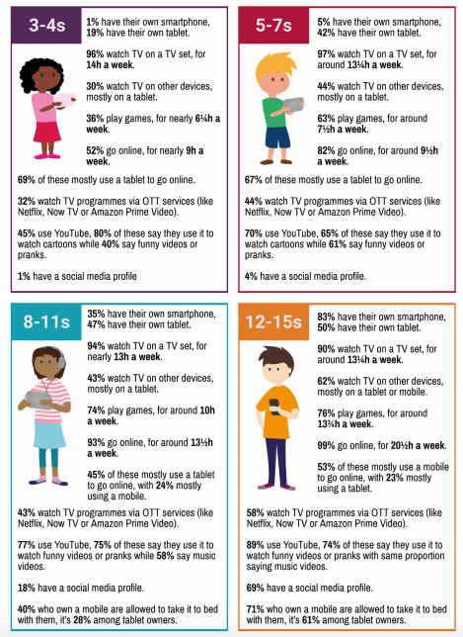
Source: Children and Parents: Media Use and attitudes report 2018
For access to the full report Click Here.

Slide 5
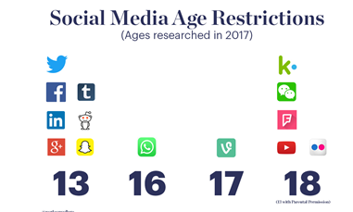

Slide 6
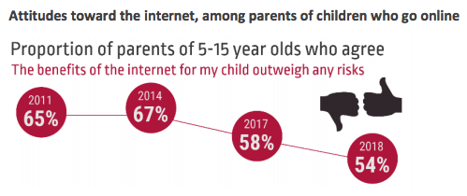
Parents
“He was addicted to [his tablet]. I didn’t want him getting too focused
in his own world, so I limited it” Mum of Harry aged 6
Source: Children and Parents: Media Use and attitudes report 2018
For access to the full report Click Here.

Slide 7
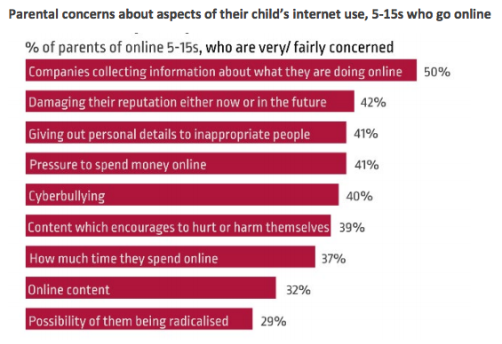
Parents
Source: Children and Parents: Media Use and attitudes report 2018
For access to the full report Click Here.

Slide 8

What can you do?

Slide 9
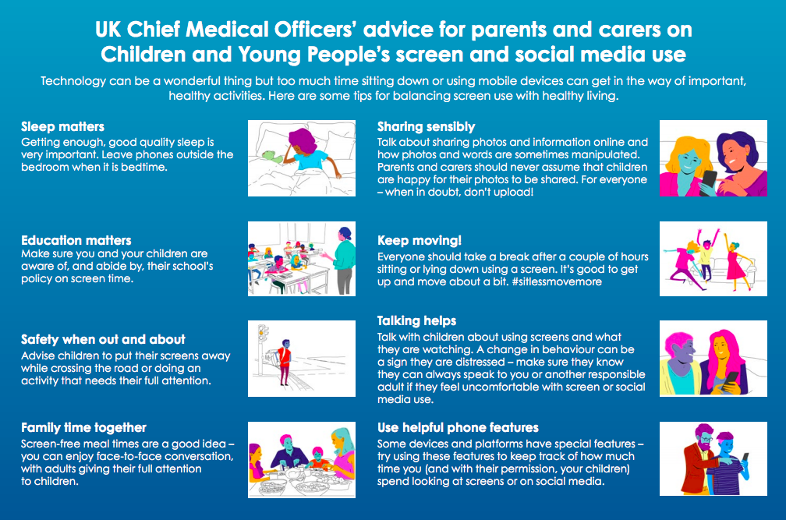
For access Click Here

Slide 10
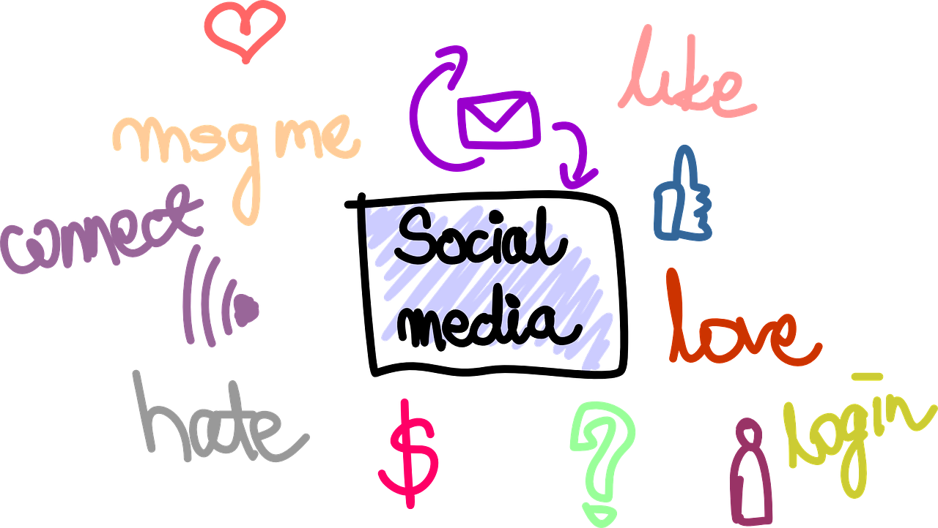
Supporting your son or daughter
Take an interest.
Engage with them.
Use technology with them.
Do not become a ‘sharent’ - lead by example.
Talk to other parents about any issues.
Open minded to technology.

Slide 11






Online Safety Books
Digiduck Smartie the Penguin

Slide 12
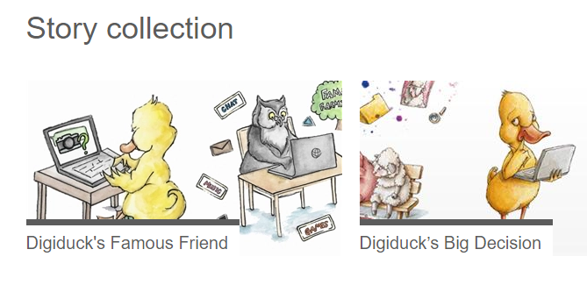
https://www.childnet.com/resources/digiduck-stories

Slide 13

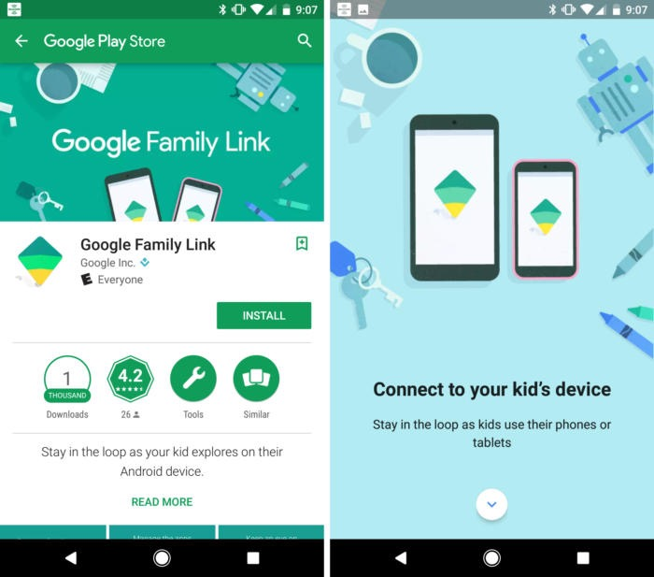
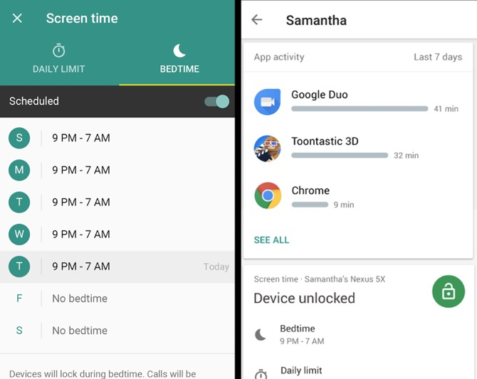
Google Family Link
Setting up Family Link takes approx 15 minutes.

Slide 14
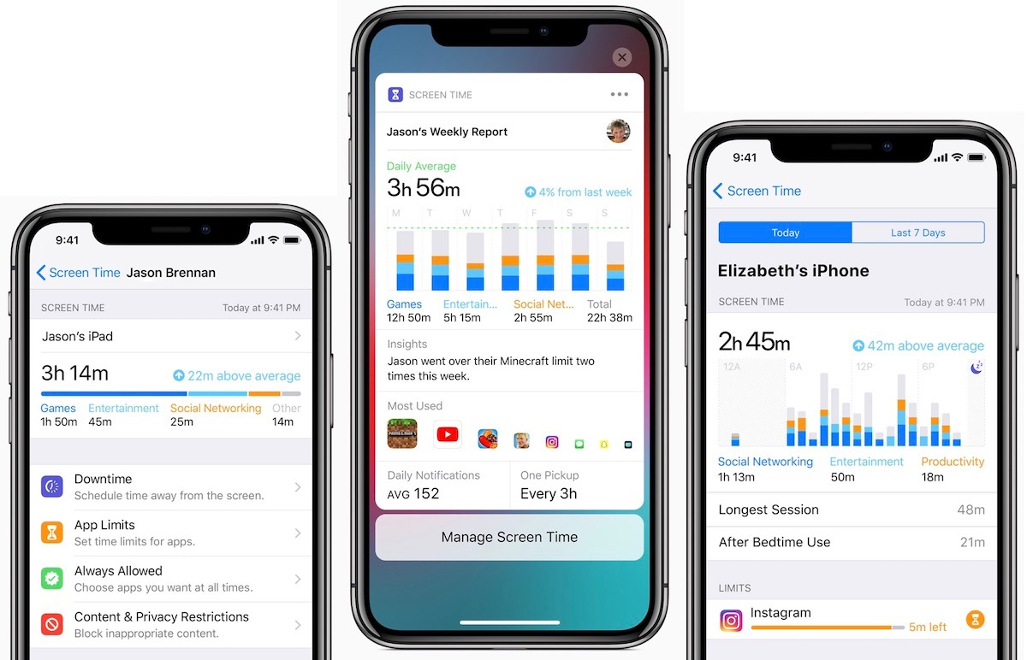
iOS Parental Controls
Includes a feature known as "Screen Time". That tool logs what apps and activities people do with their phone, and presents it all in one easy to use chart.
The phone will log whether people are spending all their time on social media, for instance. And it also measures other data like how many notifications arrive and how often owners pick up their phones.
One important group affected by the changes are children. Apple allows the Screen Time feature to be controlled within families – meaning, for instance, that parents can set limits for their children, who can ask for more time if they need it.

Slide 15


Who can help?
CEOP
https://www.ceop.police.uk/safety-centre/
Other Parents
School Teachers
Police
NSPCC
https://www.nspcc.org.uk/
Childline
https://www.childline.org.uk/

